Slide 1
What movie do you want to watch next?
predicting movie success using Movies MARK®

Slide 2

Everyone loves movies.
Streaming has reshaped cinema and the COVID-19 pandemic has left many of us wondering “what should we watch next?”
Using data-wrangling, programming, and machine learning skills, we plan to answer:
What makes movies successful?

Slide 3


Our MARK Team
of budding Data Scientists collaborated virtually across Zoom and Slack (as “the_clever_crew”) to bring you this fine work.
Maggie Allen Presentation + GitHub + Dashboard
Andrew Malony GitHub + Graphs + Dashboard
Rose Baumann Database + Data Clean-up
Kathy Morrissey Data ETL + Machine Learning Model

Slide 4
But first we must ask
How do we define Movie Success?

Slide 5

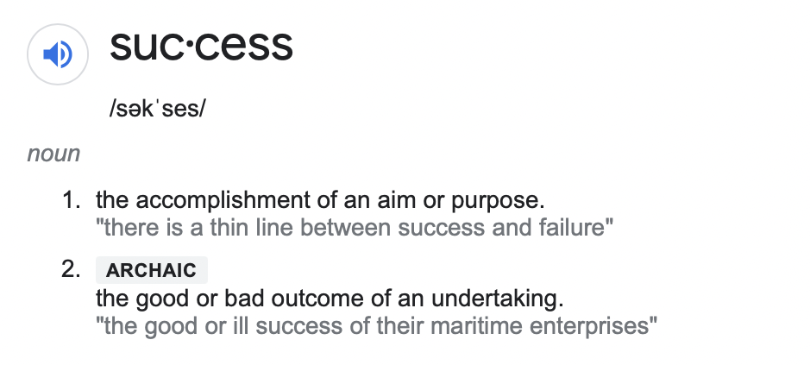
suc•cess
The Google Translate app can repeat anything you say in up to NINETY LANGUAGES from German and Japanese to Czech and Zulu
Popularity (Proprietary Scores, User Ratings, Critic Ratings)
Estimated Profitability (Revenue-Budget)
Awards

Slide 6


Meet Ellen.
She is the owner of a new start up streaming service, Serenity Streaming. She’s looking to use AI and Machine Learning to help connect users with their favorite movie they have never even heard of.
Right now she’s still working out of her home office and realizes despite a ton of data, she needs a proof of concept machine learning model to get investment interest.

Slide 7

Meet Sam.
Sam is a newly promoted executive at ABC Movie Productions and is interested in determining the right mix of movie genre, Director’s talents, and A-list actors are going to be the recipe for the next blockbuster.
Before him, the boomers were sitting in rooms making all the calls but he thinks data science can flip the script.

Slide 8
Meet Steel.
He recently had a baby so he has no time to watch a bunch of bad movies. When he finally has a free evening, he wants the first movie he streams to be one he’s happy to talk about with his new baby boy.
Let’s see what he should look for in his next popcorn night’s entertainment...

Slide 9
Spoiler Alert:
Our proof of concept was limited to analyzing ratings numeric variables.

Slide 10


Internet Movies DataBase (IMDb)
The Movies DataBase (TMDB)
Kaggle Movies DataSet (not used)
WikiPedia (not used)
Worldwide
Movies
Directors
Our Data Exploration
Actors
Genres
1970+
Budget
MetaScore
Revenue
User Ratings
Source: https://www.imdb.com
https://www.themoviedb.org/?language=en-US
https://www.kaggle.com/rounakbanik/the-movies-dataset
Critic Scores

Slide 11
Data >
AWS RD + S3 >
Postgres >
Jupyter Notebook >
Pandas >
55 Categorical Variables
Our Data Exploration
13 Numerical Variables
2 Boolean Variables
+
70 Total Variables

Slide 12
Where do we talk about the database?
Need content from Rose
Rose

Slide 13
Technologies
Data Cleaning + Analysis: Python 3.8.5, Pandas Library 1.3.2 (and dozens more) in Jupyter Notebook 6.1.4
Data Storage: PostgresSQL database 13.3 hosted on Amazon Web Services
Machine Learning: Skikit-Learn 0.24 + dozens of additional Python libraries in Jupyter Notebook 6.1.4
Dashboard: matplolib 3.4.3 using Jupyter Notebook 6.1.4 + Tableau 2021.2.2

Slide 14

1M data entries
76k rows of data
Our data was filtered, cleaned, and joined to remove missing data, filter by relevant content, and categorical variables were converted for machine learning data modeling.

Slide 15
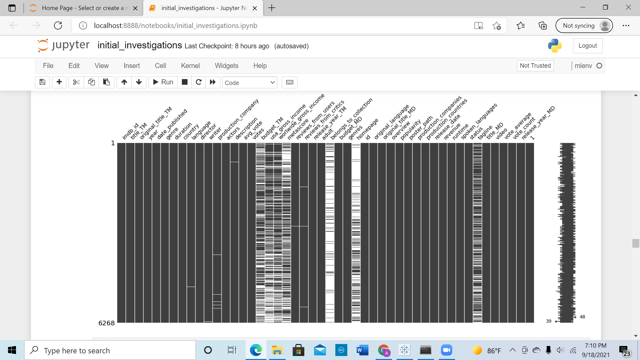
Add slide with missing data
Missing Data

Slide 16
Other Data Issues
We Encountered
Our Data Transformation
Missing data in success variables
Proprietary data
Lots of categorical data
Mismatched datatypes
Multiple entries per cell

Slide 17
Data Model Stuff
Need to add our three - four models in a visual way so we can speak to these. May need bullets from Kathy.
Movies MARK®

Slide 18
Placeholder for analysis slides

Slide 19
Placeholder for Dashboard Slides + Interactive Graphs

Slide 20
Where do we go from here?
Seek Out Additional Data Sources (Awards, A-list, Rotten Tomato, etc.)
Natural Language Processing of Reviews
Deep Dive Categorical Variables
Machine Learning Models for Predicting Future Success

Slide 21
Clever saying to finish us off on a note with a touch of humor..
Some sort of summary bullet of interest.

Slide 22
:(
POPULARITY DATA
BUDGET/REVENUE DATA
AWARDS DATA
:(
Is it a coincidence that our instructor is the only happy camper in the bunch? Maybe...
:)

Slide 23

Fin

Slide 24

Thank you.

Slide 25
APPENDIX

Slide 26
Link to Repository
Link to ReadMe.md file
Link to Profile Report

Slide 27
Pretty Graphs
October 2020
October 2021
August 2021
November 2021
A trigger to kick us off
Timing of an event
2020 |  |  |  | 2021
Something interesting
Moment of consideration

Slide 28
Then, Steel discovered Movies MARK®
Now he can use our simple list of factors to determine if this is a movie he would be happy to watch..

Slide 29
The Google Translate app can repeat anything you say in up to NINETY LANGUAGES from German and Japanese to Czech and Zulu

Slide 30
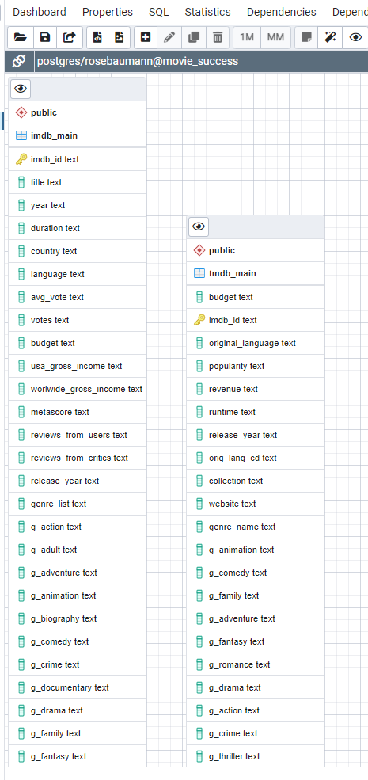
Our ERD

Slide 31
LIBRARIES AND TECHNOLOGIES LOADED ON OUR LOCAL MACHINE TO COMPLETE ETL
$ pip freeze
absl-py @ file:///C:/ci/absl-py_1623867338309/work
alabaster==0.7.12
anaconda-client==1.7.2
anaconda-project @ file:///tmp/build/80754af9/anaconda-project_1610472525955/work
anyio @ file:///C:/ci/anyio_1620153167783/work/dist
appdirs==1.4.4
argh==0.26.2
argon2-cffi @ file:///C:/ci/argon2-cffi_1613038019788/work
asn1crypto @ file:///tmp/build/80754af9/asn1crypto_1596577642040/work
astor==0.8.1
astroid @ file:///C:/ci/astroid_1613500971479/work
astropy @ file:///C:/ci/astropy_1617745665646/work
astunparse==1.6.3
async-generator==1.10
atomicwrites==1.4.0
attrs @ file:///tmp/build/80754af9/attrs_1604765588209/work
autopep8 @ file:///tmp/build/80754af9/autopep8_1615918855173/work
Babel @ file:///tmp/build/80754af9/babel_1607110387436/work
backcall==0.2.0
backports.shutil-get-terminal-size @ file:///tmp/build/80754af9/backports.shutil_get_terminal_size_1608222128777/work
bcrypt @ file:///C:/ci/bcrypt_1597918112552/work
beautifulsoup4 @ file:///home/linux1/recipes/ci/beautifulsoup4_1610988766420/work
bitarray @ file:///C:/ci/bitarray_1618435050316/work
bkcharts==0.2
black==19.10b0
bleach @ file:///tmp/build/80754af9/bleach_1612211392645/work
blinker==1.4
bokeh @ file:///C:/ci/bokeh_1620784051578/work
boto==2.49.0
Bottleneck==1.3.2
brotlipy==0.7.0
cachetools @ file:///tmp/build/80754af9/cachetools_1619597386817/work
certifi==2020.12.5
cffi @ file:///C:/ci/cffi_1613247308275/work
chardet @ file:///C:/ci/chardet_1607706910910/work
click @ file:///home/linux1/recipes/ci/click_1610990599742/work
cloudpickle @ file:///tmp/build/80754af9/cloudpickle_1598884132938/work
clyent==1.2.2
colorama==0.4.4
comtypes==1.1.9
contextlib2==0.6.0.post1
coverage @ file:///C:/ci/coverage_1614614910274/work
cryptography @ file:///C:/ci/cryptography_1616769432139/work
cycler==0.10.0
Cython @ file:///C:/ci/cython_1618435342622/work
cytoolz==0.11.0
dask @ file:///tmp/build/80754af9/dask-core_1617390489108/work
decorator==5.0.7
defusedxml @ file:///tmp/build/80754af9/defusedxml_1615228127516/work
diff-match-patch @ file:///tmp/build/80754af9/diff-match-patch_1594828741838/work
distributed @ file:///C:/ci/distributed_1617384292700/work
docutils @ file:///C:/ci/docutils_1617481620173/work
entrypoints==0.3
et-xmlfile==1.0.1
fastcache==1.1.0
filelock @ file:///home/linux1/recipes/ci/filelock_1610993975404/work
flake8 @ file:///tmp/build/80754af9/flake8_1615834841867/work
Flask @ file:///home/ktietz/src/ci/flask_1611932660458/work
fsspec @ file:///tmp/build/80754af9/fsspec_1617959894824/work
future==0.18.2
gast==0.3.3
gevent @ file:///C:/ci/gevent_1616773028237/work
glob2 @ file:///home/linux1/recipes/ci/glob2_1610991677669/work
google-auth @ file:///tmp/build/80754af9/google-auth_1600960338579/work
google-auth-oauthlib @ file:///tmp/build/80754af9/google-auth-oauthlib_1617120569401/work
google-pasta==0.2.0
greenlet @ file:///C:/ci/greenlet_1611958376725/work
grpcio @ file:///C:/ci/grpcio_1614884419385/work
h5py==2.10.0
HeapDict==1.0.1
html5lib @ file:///tmp/build/80754af9/html5lib_1593446221756/work
idna @ file:///home/linux1/recipes/ci/idna_1610986105248/work
imagecodecs @ file:///C:/ci/imagecodecs_1617996781001/work
imageio @ file:///tmp/build/80754af9/imageio_1617700267927/work
imagesize @ file:///Users/ktietz/demo/mc3/conda-bld/imagesize_1628863108022/work
imbalanced-learn @ file:///home/conda/feedstock_root/build_artifacts/imbalanced-learn_1613662486985/work
importlib-metadata @ file:///C:/ci/importlib-metadata_1617877486026/work
iniconfig @ file:///home/linux1/recipes/ci/iniconfig_1610983019677/work
intervaltree @ file:///tmp/build/80754af9/intervaltree_1598376443606/work
ipykernel==5.5.3
ipython==7.23.0
ipython-genutils==0.2.0
ipywidgets @ file:///tmp/build/80754af9/ipywidgets_1610481889018/work
isort @ file:///tmp/build/80754af9/isort_1616355431277/work
itsdangerous==1.1.0
jdcal==1.4.1
jedi==0.18.0
Jinja2 @ file:///tmp/build/80754af9/jinja2_1612213139570/work
joblib @ file:///tmp/build/80754af9/joblib_1613502643832/work
json5==0.9.5
jsonschema @ file:///tmp/build/80754af9/jsonschema_1602607155483/work
jupyter==1.0.0
jupyter-client==6.1.12
jupyter-console @ file:///tmp/build/80754af9/jupyter_console_1616615302928/work
jupyter-contrib-core==0.3.3
jupyter-core==4.7.1
jupyter-nbextensions-configurator @ file:///D:/bld/jupyter_nbextensions_configurator_1611341300533/work
jupyter-packaging @ file:///tmp/build/80754af9/jupyter-packaging_1613502826984/work
jupyter-server @ file:///C:/ci/jupyter_server_1616084265530/work
jupyterlab @ file:///tmp/build/80754af9/jupyterlab_1619133235951/work
jupyterlab-pygments @ file:///tmp/build/80754af9/jupyterlab_pygments_1601490720602/work
jupyterlab-server @ file:///tmp/build/80754af9/jupyterlab_server_1617134334258/work
jupyterlab-widgets @ file:///tmp/build/80754af9/jupyterlab_widgets_1609884341231/work
Keras @ file:///tmp/build/80754af9/keras_split_1593112142734/work
Keras-Applications @ file:///tmp/build/80754af9/keras-applications_1594366238411/work
Keras-Preprocessing @ file:///tmp/build/80754af9/keras-preprocessing_1612283640596/work
keyring @ file:///C:/ci/keyring_1614630298708/work
kiwisolver @ file:///C:/ci/kiwisolver_1612282618948/work
lazy-object-proxy @ file:///C:/ci/lazy-object-proxy_1616529290879/work
libarchive-c @ file:///tmp/build/80754af9/python-libarchive-c_1617780486945/work
llvmlite==0.36.0
locket==0.2.1
lxml @ file:///C:/ci/lxml_1616443391272/work
Markdown @ file:///C:/ci/markdown_1614364005059/work
MarkupSafe @ file:///C:/ci/markupsafe_1594405949945/work
matplotlib @ file:///C:/ci/matplotlib-suite_1613408055530/work
matplotlib-inline==0.1.2
mccabe==0.6.1
menuinst==1.4.16
mistune @ file:///C:/ci/mistune_1594373272338/work
mkl-fft==1.3.0
mkl-random @ file:///C:/ci/mkl_random_1618854593605/work
mkl-service==2.3.0
mock @ file:///tmp/build/80754af9/mock_1607622725907/work
more-itertools @ file:///tmp/build/80754af9/more-itertools_1613676688952/work
mpmath==1.2.1
msgpack @ file:///C:/ci/msgpack-python_1612287191162/work
multipledispatch==0.6.0
mypy-extensions==0.4.3
nbclassic @ file:///tmp/build/80754af9/nbclassic_1616085367084/work
nbclient @ file:///tmp/build/80754af9/nbclient_1614364831625/work
nbconvert @ file:///C:/ci/nbconvert_1601914921407/work
nbformat @ file:///tmp/build/80754af9/nbformat_1617383369282/work
nest-asyncio @ file:///tmp/build/80754af9/nest-asyncio_1613680548246/work
networkx @ file:///tmp/build/80754af9/networkx_1598376031484/work
nltk @ file:///tmp/build/80754af9/nltk_1618327084230/work
nose @ file:///tmp/build/80754af9/nose_1606773131901/work
notebook @ file:///C:/ci/notebook_1616443616158/work
numba @ file:///C:/ci/numba_1616774290339/work
numexpr @ file:///C:/ci/numexpr_1618856761305/work
numpy @ file:///C:/ci/numpy_and_numpy_base_1618497408168/work
numpydoc @ file:///tmp/build/80754af9/numpydoc_1605117425582/work
oauthlib @ file:///tmp/build/80754af9/oauthlib_1623060228408/work
olefile==0.46
openpyxl @ file:///tmp/build/80754af9/openpyxl_1615411699337/work
opt-einsum @ file:///tmp/build/80754af9/opt_einsum_1621500238896/work
packaging @ file:///tmp/build/80754af9/packaging_1611952188834/work
pandas @ file:///C:/ci/pandas_1618365631664/work
pandocfilters @ file:///C:/ci/pandocfilters_1605102427207/work
paramiko @ file:///tmp/build/80754af9/paramiko_1598886428689/work
parso==0.8.2
partd @ file:///tmp/build/80754af9/partd_1618000087440/work
path @ file:///C:/ci/path_1614022434895/work
pathlib2 @ file:///C:/ci/pathlib2_1607025068091/work
pathspec==0.7.0
patsy==0.5.1
pep8==1.7.1
pexpect @ file:///tmp/build/80754af9/pexpect_1605563209008/work
pickleshare==0.7.5
Pillow @ file:///C:/ci/pillow_1617386319301/work
pkginfo==1.7.0
pluggy @ file:///C:/ci/pluggy_1615976530170/work
ply==3.11
prometheus-client @ file:///tmp/build/80754af9/prometheus_client_1618088486455/work
prompt-toolkit==3.0.18
protobuf==3.17.2
psutil @ file:///C:/ci/psutil_1612298033174/work
psycopg2 @ file:///C:/ci/psycopg2_1612298715048/work
ptyprocess @ file:///tmp/build/80754af9/ptyprocess_1609355006118/work/dist/ptyprocess-0.7.0-py2.py3-none-any.whl
py @ file:///tmp/build/80754af9/py_1607971587848/work
pyasn1==0.4.8
pyasn1-modules==0.2.8
pycodestyle @ file:///home/ktietz/src/ci_mi/pycodestyle_1612807597675/work
pycosat==0.6.3
pycparser @ file:///tmp/build/80754af9/pycparser_1594388511720/work
pycrypto==2.6.1
pycurl==7.43.0.6
pydocstyle @ file:///tmp/build/80754af9/pydocstyle_1616182067796/work
pyerfa @ file:///C:/ci/pyerfa_1619391058121/work
pyflakes @ file:///home/ktietz/src/ci_ipy2/pyflakes_1612551159640/work
Pygments==2.8.1
PyJWT @ file:///C:/ci/pyjwt_1619651810943/work
pylint @ file:///C:/ci/pylint_1617135975189/work
pyls-black @ file:///tmp/build/80754af9/pyls-black_1607553132291/work
pyls-spyder @ file:///tmp/build/80754af9/pyls-spyder_1613849700860/work
PyNaCl @ file:///C:/ci/pynacl_1595009241355/work
pyodbc===4.0.0-unsupported
pyOpenSSL @ file:///tmp/build/80754af9/pyopenssl_1608057966937/work
pyparsing @ file:///home/linux1/recipes/ci/pyparsing_1610983426697/work
pyreadline==2.1
pyrsistent @ file:///C:/ci/pyrsistent_1600123688363/work
PySocks @ file:///C:/ci/pysocks_1594394709107/work
pytest==6.2.3
python-dateutil==2.8.1
python-jsonrpc-server @ file:///tmp/build/80754af9/python-jsonrpc-server_1600278539111/work
python-language-server @ file:///tmp/build/80754af9/python-language-server_1607972495879/work
pytz @ file:///tmp/build/80754af9/pytz_1612215392582/work
PyWavelets @ file:///C:/ci/pywavelets_1601658407053/work
pywin32==300
pywin32-ctypes @ file:///C:/ci/pywin32-ctypes_1594392691209/work
pywinpty==0.5.7
PyYAML==5.4.1
pyzmq==22.0.3
QDarkStyle==2.8.1
QtAwesome @ file:///tmp/build/80754af9/qtawesome_1615991616277/work
qtconsole @ file:///tmp/build/80754af9/qtconsole_1616775094278/work
QtPy==1.9.0
regex @ file:///C:/ci/regex_1617569892025/work
requests @ file:///tmp/build/80754af9/requests_1608241421344/work
requests-oauthlib==1.3.0
rope @ file:///tmp/build/80754af9/rope_1602264064449/work
rsa @ file:///tmp/build/80754af9/rsa_1614366226499/work
Rtree @ file:///C:/ci/rtree_1618421019532/work
ruamel-yaml-conda @ file:///C:/ci/ruamel_yaml_1616016865685/work
scikit-image==0.18.1
scikit-learn @ file:///C:/ci/scikit-learn_1614446716349/work
scipy @ file:///C:/ci/scipy_1618856134946/work
seaborn @ file:///tmp/build/80754af9/seaborn_1608578541026/work
Send2Trash @ file:///tmp/build/80754af9/send2trash_1607525499227/work
simplegeneric==0.8.1
singledispatch @ file:///tmp/build/80754af9/singledispatch_1614366001199/work
six==1.15.0
sniffio @ file:///C:/ci/sniffio_1614030522573/work
snowballstemmer @ file:///tmp/build/80754af9/snowballstemmer_1611258885636/work
sortedcollections @ file:///tmp/build/80754af9/sortedcollections_1611172717284/work
sortedcontainers @ file:///tmp/build/80754af9/sortedcontainers_1606865132123/work
soupsieve @ file:///tmp/build/80754af9/soupsieve_1616183228191/work
Sphinx @ file:///tmp/build/80754af9/sphinx_1620777493457/work
sphinxcontrib-applehelp @ file:///home/ktietz/src/ci/sphinxcontrib-applehelp_1611920841464/work
sphinxcontrib-devhelp @ file:///home/ktietz/src/ci/sphinxcontrib-devhelp_1611920923094/work
sphinxcontrib-htmlhelp @ file:///home/ktietz/src/ci/sphinxcontrib-htmlhelp_1611920974801/work
sphinxcontrib-jsmath @ file:///home/ktietz/src/ci/sphinxcontrib-jsmath_1611920942228/work
sphinxcontrib-qthelp @ file:///home/ktietz/src/ci/sphinxcontrib-qthelp_1611921055322/work
sphinxcontrib-serializinghtml @ file:///home/ktietz/src/ci/sphinxcontrib-serializinghtml_1611920755253/work
sphinxcontrib-websupport @ file:///tmp/build/80754af9/sphinxcontrib-websupport_1597081412696/work
spyder @ file:///C:/ci/spyder_1616776686228/work
spyder-kernels @ file:///C:/ci/spyder-kernels_1614030834721/work
SQLAlchemy @ file:///C:/ci/sqlalchemy_1618090063585/work
statsmodels==0.12.2
sympy @ file:///C:/ci/sympy_1618255481827/work
tables==3.6.1
tblib @ file:///tmp/build/80754af9/tblib_1597928476713/work
tensorboard @ file:///home/builder/ktietz/aggregate/tensorflow_recipes/ci_te/tensorboard_1614593728657/work/tmp_pip_dir
tensorboard-plugin-wit==1.6.0
tensorflow==2.3.0
tensorflow-estimator @ file:///home/builder/ktietz/aggregate/tensorflow_recipes/ci_baze37/tensorflow-estimator_1622026529081/work/tensorflow_estimator-2.5.0-py2.py3-none-any.whl
termcolor==1.1.0
terminado==0.9.4
testpath @ file:///home/ktietz/src/ci/testpath_1611930608132/work
textdistance @ file:///tmp/build/80754af9/textdistance_1612461398012/work
threadpoolctl @ file:///tmp/tmp9twdgx9k/threadpoolctl-2.1.0-py3-none-any.whl
three-merge @ file:///tmp/build/80754af9/three-merge_1607553261110/work
tifffile @ file:///tmp/build/80754af9/tifffile_1619636090847/work
toml @ file:///tmp/build/80754af9/toml_1616166611790/work
toolz @ file:///home/linux1/recipes/ci/toolz_1610987900194/work
tornado==6.1
tqdm @ file:///tmp/build/80754af9/tqdm_1615925068909/work
traitlets==5.0.5
typed-ast @ file:///C:/ci/typed-ast_1610484654578/work
typing-extensions @ file:///home/ktietz/src/ci_mi/typing_extensions_1612808209620/work
ujson @ file:///C:/ci/ujson_1611244941645/work
unicodecsv==0.14.1
urllib3 @ file:///tmp/build/80754af9/urllib3_1615837158687/work
watchdog @ file:///C:/ci/watchdog_1612471244702/work
wcwidth==0.2.5
webencodings==0.5.1
Werkzeug @ file:///home/ktietz/src/ci/werkzeug_1611932622770/work
widgetsnbextension==3.5.1
win-inet-pton @ file:///C:/ci/win_inet_pton_1605306165655/work
win-unicode-console==0.5
wincertstore==0.2
wrapt==1.12.1
xlrd @ file:///tmp/build/80754af9/xlrd_1608072521494/work
XlsxWriter @ file:///tmp/build/80754af9/xlsxwriter_1617224712951/work
xlwings==0.23.0
xlwt==1.3.0
yapf @ file:///tmp/build/80754af9/yapf_1615749224965/work
zict==2.0.0
zipp @ file:///tmp/build/80754af9/zipp_1615904174917/work
zope.event==4.5.0
zope.interface @ file:///C:/ci/zope.interface_1616357230604/work
(py37nbext)

Slide 32
LIBRARIES AND TECHNOLOGIES LOADED ON OUR LOCAL MACHINE TO COMPLETE ETL (cont.)
athlib2 @ file:///C:/ci/pathlib2_1607025068091/work
pathspec==0.7.0
patsy==0.5.1
pep8==1.7.1
pexpect @ file:///tmp/build/80754af9/pexpect_1605563209008/work
pickleshare==0.7.5
Pillow @ file:///C:/ci/pillow_1617386319301/work
pkginfo==1.7.0
pluggy @ file:///C:/ci/pluggy_1615976530170/work
ply==3.11
prometheus-client @ file:///tmp/build/80754af9/prometheus_client_1618088486455/work
prompt-toolkit==3.0.18
protobuf==3.17.2
psutil @ file:///C:/ci/psutil_1612298033174/work
psycopg2 @ file:///C:/ci/psycopg2_1612298715048/work
ptyprocess @ file:///tmp/build/80754af9/ptyprocess_1609355006118/work/dist/ptyprocess-0.7.0-py2.py3-none-any.whl
py @ file:///tmp/build/80754af9/py_1607971587848/work
pyasn1==0.4.8
pyasn1-modules==0.2.8
pycodestyle @ file:///home/ktietz/src/ci_mi/pycodestyle_1612807597675/work
pycosat==0.6.3
pycparser @ file:///tmp/build/80754af9/pycparser_1594388511720/work
pycrypto==2.6.1
pycurl==7.43.0.6
pydocstyle @ file:///tmp/build/80754af9/pydocstyle_1616182067796/work
pyerfa @ file:///C:/ci/pyerfa_1619391058121/work
pyflakes @ file:///home/ktietz/src/ci_ipy2/pyflakes_1612551159640/work
Pygments==2.8.1
PyJWT @ file:///C:/ci/pyjwt_1619651810943/work
pylint @ file:///C:/ci/pylint_1617135975189/work
pyls-black @ file:///tmp/build/80754af9/pyls-black_1607553132291/work
pyls-spyder @ file:///tmp/build/80754af9/pyls-spyder_1613849700860/work
PyNaCl @ file:///C:/ci/pynacl_1595009241355/work
pyodbc===4.0.0-unsupported
pyOpenSSL @ file:///tmp/build/80754af9/pyopenssl_1608057966937/work
pyparsing @ file:///home/linux1/recipes/ci/pyparsing_1610983426697/work
pyreadline==2.1
pyrsistent @ file:///C:/ci/pyrsistent_1600123688363/work
PySocks @ file:///C:/ci/pysocks_1594394709107/work
pytest==6.2.3
python-dateutil==2.8.1
python-jsonrpc-server @ file:///tmp/build/80754af9/python-jsonrpc-server_1600278539111/work
python-language-server @ file:///tmp/build/80754af9/python-language-server_1607972495879/work
pytz @ file:///tmp/build/80754af9/pytz_1612215392582/work
PyWavelets @ file:///C:/ci/pywavelets_1601658407053/work
pywin32==300
pywin32-ctypes @ file:///C:/ci/pywin32-ctypes_1594392691209/work
pywinpty==0.5.7
PyYAML==5.4.1
pyzmq==22.0.3
QDarkStyle==2.8.1
QtAwesome @ file:///tmp/build/80754af9/qtawesome_1615991616277/work
qtconsole @ file:///tmp/build/80754af9/qtconsole_1616775094278/work
QtPy==1.9.0
regex @ file:///C:/ci/regex_1617569892025/work
requests @ file:///tmp/build/80754af9/requests_1608241421344/work
requests-oauthlib==1.3.0
rope @ file:///tmp/build/80754af9/rope_1602264064449/work
rsa @ file:///tmp/build/80754af9/rsa_1614366226499/work
Rtree @ file:///C:/ci/rtree_1618421019532/work
ruamel-yaml-conda @ file:///C:/ci/ruamel_yaml_1616016865685/work
scikit-image==0.18.1
scikit-learn @ file:///C:/ci/scikit-learn_1614446716349/work
scipy @ file:///C:/ci/scipy_1618856134946/work
seaborn @ file:///tmp/build/80754af9/seaborn_1608578541026/work
Send2Trash @ file:///tmp/build/80754af9/send2trash_1607525499227/work
simplegeneric==0.8.1
singledispatch @ file:///tmp/build/80754af9/singledispatch_1614366001199/work
six==1.15.0
sniffio @ file:///C:/ci/sniffio_1614030522573/work
snowballstemmer @ file:///tmp/build/80754af9/snowballstemmer_1611258885636/work
sortedcollections @ file:///tmp/build/80754af9/sortedcollections_1611172717284/work
sortedcontainers @ file:///tmp/build/80754af9/sortedcontainers_1606865132123/work
soupsieve @ file:///tmp/build/80754af9/soupsieve_1616183228191/work
Sphinx @ file:///tmp/build/80754af9/sphinx_1620777493457/work
sphinxcontrib-applehelp @ file:///home/ktietz/src/ci/sphinxcontrib-applehelp_1611920841464/work
sphinxcontrib-devhelp @ file:///home/ktietz/src/ci/sphinxcontrib-devhelp_1611920923094/work
sphinxcontrib-htmlhelp @ file:///home/ktietz/src/ci/sphinxcontrib-htmlhelp_1611920974801/work
sphinxcontrib-jsmath @ file:///home/ktietz/src/ci/sphinxcontrib-jsmath_1611920942228/work
sphinxcontrib-qthelp @ file:///home/ktietz/src/ci/sphinxcontrib-qthelp_1611921055322/work
sphinxcontrib-serializinghtml @ file:///home/ktietz/src/ci/sphinxcontrib-serializinghtml_1611920755253/work
sphinxcontrib-websupport @ file:///tmp/build/80754af9/sphinxcontrib-websupport_1597081412696/work
spyder @ file:///C:/ci/spyder_1616776686228/work
spyder-kernels @ file:///C:/ci/spyder-kernels_1614030834721/work
SQLAlchemy @ file:///C:/ci/sqlalchemy_1618090063585/work
statsmodels==0.12.2
sympy @ file:///C:/ci/sympy_1618255481827/work
tables==3.6.1
tblib @ file:///tmp/build/80754af9/tblib_1597928476713/work
tensorboard @ file:///home/builder/ktietz/aggregate/tensorflow_recipes/ci_te/tensorboard_1614593728657/work/tmp_pip_dir
tensorboard-plugin-wit==1.6.0
tensorflow==2.3.0
tensorflow-estimator @ file:///home/builder/ktietz/aggregate/tensorflow_recipes/ci_baze37/tensorflow-estimator_1622026529081/work/tensorflow_estimator-2.5.0-py2.py3-none-any.whl
termcolor==1.1.0
terminado==0.9.4
testpath @ file:///home/ktietz/src/ci/testpath_1611930608132/work
textdistance @ file:///tmp/build/80754af9/textdistance_1612461398012/work
threadpoolctl @ file:///tmp/tmp9twdgx9k/threadpoolctl-2.1.0-py3-none-any.whl
three-merge @ file:///tmp/build/80754af9/three-merge_1607553261110/work
tifffile @ file:///tmp/build/80754af9/tifffile_1619636090847/work
toml @ file:///tmp/build/80754af9/toml_1616166611790/work
toolz @ file:///home/linux1/recipes/ci/toolz_1610987900194/work
tornado==6.1
tqdm @ file:///tmp/build/80754af9/tqdm_1615925068909/work
traitlets==5.0.5
typed-ast @ file:///C:/ci/typed-ast_1610484654578/work
typing-extensions @ file:///home/ktietz/src/ci_mi/typing_extensions_1612808209620/work
ujson @ file:///C:/ci/ujson_1611244941645/work
unicodecsv==0.14.1
urllib3 @ file:///tmp/build/80754af9/urllib3_1615837158687/work
watchdog @ file:///C:/ci/watchdog_1612471244702/work
wcwidth==0.2.5
webencodings==0.5.1
Werkzeug @ file:///home/ktietz/src/ci/werkzeug_1611932622770/work
widgetsnbextension==3.5.1
win-inet-pton @ file:///C:/ci/win_inet_pton_1605306165655/work
win-unicode-console==0.5
wincertstore==0.2
wrapt==1.12.1
xlrd @ file:///tmp/build/80754af9/xlrd_1608072521494/work
XlsxWriter @ file:///tmp/build/80754af9/xlsxwriter_1617224712951/work
xlwings==0.23.0
xlwt==1.3.0
yapf @ file:///tmp/build/80754af9/yapf_1615749224965/work
zict==2.0.0
zipp @ file:///tmp/build/80754af9/zipp_1615904174917/work
zope.event==4.5.0
zope.interface @ file:///C:/ci/zope.interface_1616357230604/work
(py37nbext)

